Slide 1


Computational Structures in Data Science
Lecture 5: Recursion
UC Berkeley EECS Adj. Ass. Prof. Dr. Gerald Friedland
February 25, 2019
http://inst.eecs.berkeley.edu/~cs88

Slide 2
Administrative Issues
Where is Lecture 4? See Last slides.
Labs are to help you learn the materials, so please make full use of them
Materials for midterm go through March 4th Lecture.

Slide 3

Computational Concepts Toolbox
Data type: values, literals, operations,
e.g., int, float, string
Expressions, Call expression
Variables
Assignment Statement
Sequences: tuple, list
indexing
Data structures
Tuple assignment
Call Expressions
Function Definition Statement
Conditional Statement
Iteration:
data-driven (list comprehension)
control-driven (for statement)
while statement
Higher Order Functions
Functions as Values
Functions with functions as argument
Assignment of function values
Higher order function patterns
Map, Filter, Reduce
Function factories – create and return functions
Notes:
z = 1,2
x,y = 3,4
a,b = z

Slide 4
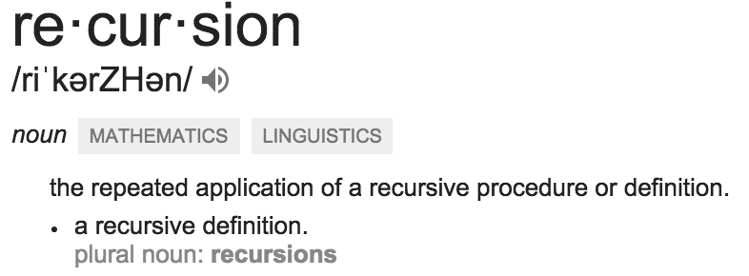
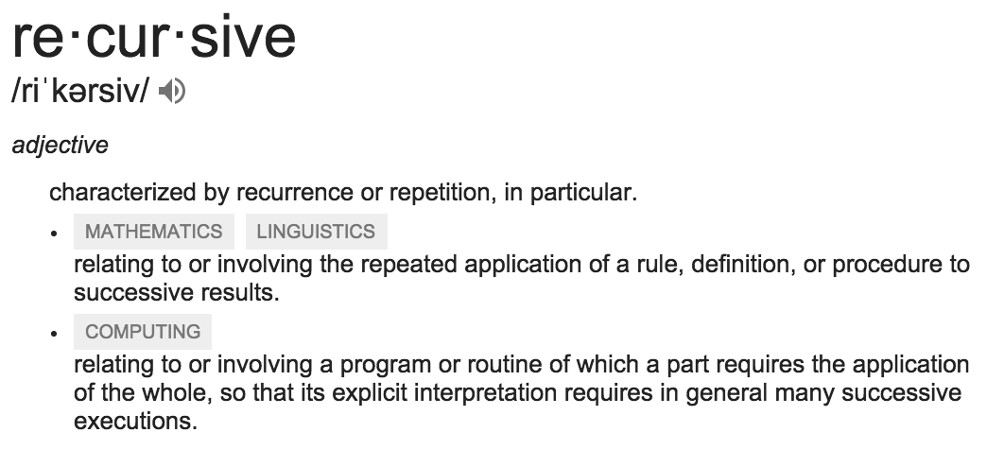
Today: Recursion
Recursive function calls itself, directly or indirectly

Slide 5
Review: Functions
def <function name> (<argument list>) :
expression
return
def concat(str1, str2):
return str1+str2;
concat(“Hello”,”World”)
Generalizes an expression or set of statements to apply to lots of instances of the problem
A function should do one thing well

Slide 6
Review: Higher Order Functions
Functions that operate on functions
A function
A function that takes a function arg
def odd(x):
return x%2
>>> odd(3)
1
Why is this not ‘odd’ ?
def filter(fun, s):
return [x for x in s if fun(x)]
>>> filter(odd, [0,1,2,3,4,5,6,7])
[1, 3, 5, 7]

Slide 7
Review Higher Order Functions (cont)
A function that returns (makes) a function
def leq_maker(c):
def leq(val):
return val <= c
return leq
>>> leq_maker(3)
<function leq_maker.<locals>.leq at 0x1019d8c80>
>>> leq_maker(3)(4)
False
>>> filter(leq_maker(3), [0,1,2,3,4,5,6,7])
[0, 1, 2, 3]
>>>

Slide 8
Review: One more example
What does this function do?
def split_fun(p, s):
””” Returns <you fill this in>."""
return [i for i in s if p(i)], [i for i in s if not p(i)]
>>> split_fun(leq_maker(3), [0,1,2,3,4,5,6])
([0, 1, 2, 3], [4, 5, 6])

Slide 9
Function Review
A function cannot… A) have a function as argument B) define a function within itself C) return a function D) call itself E) None of the above.
Solution: E) A, B, C, D are all possible!

Slide 10
Function Review
A Python function can… A) not return a value B) return different values for the same input C) halt the entire program D) change global variables E) All of the above.
Solution: E) A, B, C, D are all possible!

Slide 11
Recall: Iteration
1. Initialize the “base” case of no iterations
2. Starting value
def sum_of_squares(n):
accum = 0
for i in range(1,n+1):
accum = accum + i*i
return accum
3. Ending value
4. New loop variable value

Slide 12
Recursion Key concepts – by example
1. Test for simple “base” case
2. Solution in simple “base” case
def sum_of_squares(n):
if n < 1:
return 0
else:
return sum_of_squares(n-1) + n**2
3. Assume recusive solution to simpler problem
4. Transform soln of simpler problem into full soln

Slide 13
In words
The sum of no numbers is zero
The sum of 1² through n² is the
sum of 1² through (n-1)²
plus n²
def sum_of_squares(n):
if n < 1:
return 0
else:
return sum_of_squares(n-1) + n**2

Slide 14
Why does it work
sum_of_squares(3)
# sum_of_squares(3) => sum_of_squares(2) + 3**2
# => sum_of_squares(1) + 2**2 + 3**2
# => sum_of_squares(0) + 1**2 + 2**2 + 3**2
# => 0 + 1**2 + 2**2 + 3**2 = 14

Slide 15
How does it work?
Each recursive call gets its own local variables
Just like any other function call
Computes its result (possibly using additional calls)
Just like any other function call
Returns its result and returns control to its caller
Just like any other function call
The function that is called happens to be itself
Called on a simpler problem
Eventually bottoms out on the simple base case
Reason about correctness “by induction”
Solve a base case
Assuming a solution to a smaller problem, extend it

Slide 16
Questions
In what order do we sum the squares ?
How does this compare to iterative approach ?
def sum_of_squares(n):
accum = 0
for i in range(1,n+1):
accum = accum + i*i
return accum
def sum_of_squares(n):
if n < 1:
return 0
else:
return sum_of_squares(n-1) + n**2
def sum_of_squares(n):
if n < 1:
return 0
else:
return n**2 + sum_of_squares(n-1)

Slide 17
Tail Recursion
All the work happens on the way down the recursion
On the way back up, just return
def sum_up_squares(i, n, accum):
"""Sum the squares from i to n in incr. order"""
if i > n:
return accum
else:
return sum_up_squares(i+1, n, accum + i**2)
>>> sum_up_squares(1,3,0)
14
Base Case
Tail Recursive Case

Slide 18
Local variables
def sum_of_squares(n):
n_squared = n**2
if n < 1:
return 0
else:
return n_squared + sum_of_squares(n-1)
Each call has its own “frame” of local variables
What about globals?
Let’s see the environment diagrams (next lecture)
https://goo.gl/CiFaUJ

Slide 19
Iteration vs Recursion
For loop:
def sum(n):
s=0
for i in range(0,n+1):
s=s+i
return s

Slide 20
Iteration vs Recursion
While loop:
def sum(n):
s=0
i=0
while i<n:
i=i+1
s=s+i
return s

Slide 21
Iteration vs Recursion
Recursion:
def sum(n):
if n==0:
return 0
return n+sum(n-1)

Slide 22
For Homework
fibonacci(n) = fibonacci(n-1) + fibonacci(n-2)
where fibonacci(1) == fibonacci(0) == 1

Slide 23
Another Example
indexing an element of a sequence
def first(s):
"""Return the first element in a sequence."""
return s[0]
def rest(s):
"""Return all elements in a sequence after the first"""
return s[1:]
def min_r(s):
“””Return minimum value in a sequence.”””
if len(s) == 1:
return first(s)
else:
return min(first(s), min_r(rest(s)))
Slicing a sequence of elements
Base Case
Recursive Case
Recursion over sequence length, rather than number magnitude

Slide 24
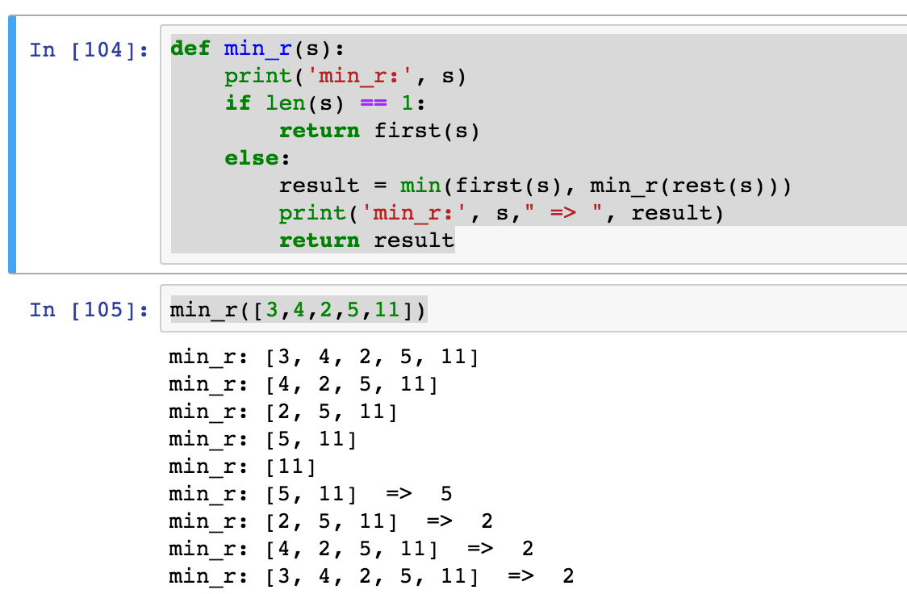
Visualize its behavior (print)
What about sum?
Don’t confuse print with return value

Slide 25
Trust …
The recursive “leap of faith” works as long as we hit the base case eventually
What happens if we don’t?

Slide 26
Recursion
Recursion is…
A) Less powerful than a for loop B) As powerful as a for loop C) As powerful as a while loop D) More powerful than a while loop E) Just different all together
Solution: C) Any recursion can be formulated as a while loop and any while loop can be formulated as a recursion (with a global variable).

Slide 27
Why Recursion?
“After Abstraction, Recursion is probably the 2nd biggest idea in this course”
“It’s tremendously useful when the problem is self-similar”
“It’s no more powerful than iteration, but often leads to more concise & better code”
“It’s more ‘mathematical’”
“It embodies the beauty and joy of computing”
…

Slide 28
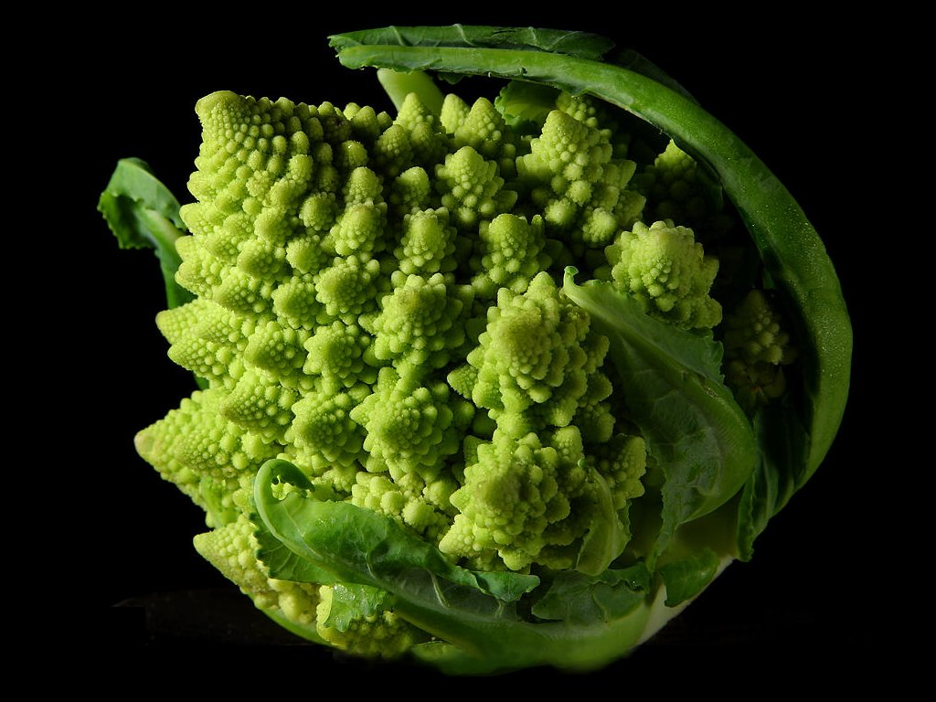
Why Recursion? More Reasons
Recursive structures exist (sometimes hidden) in nature and therefore in data!
It’s mentally and sometimes computationally more efficient to process recursive structures using recursion.

Slide 29

Recursion (unwanted)

Slide 30
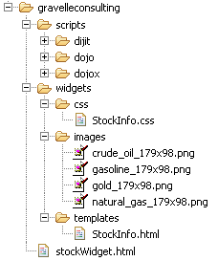
Example I
List all items on your hard disk
Files
Folders contain
Files
Folders
Recursion!

Slide 31
List Files in Python
def listfiles(directory):
content = [os.path.join(directory, x) for x in os.listdir(directory)]
dirs = sorted([x for x in content if os.path.isdir(x)])
files = sorted([x for x in content if os.path.isfile(x)])
for d in dirs:
print d
listfiles(d)
for f in files:
print f
Iterative version about twice as much code and much harder to think about.

Slide 32
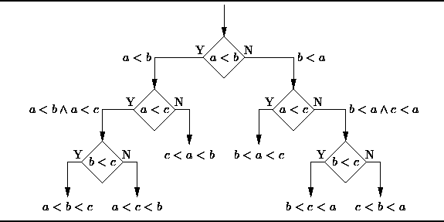
Example II
Sort the numbers in a list.
Hidden recursive structure: Decision tree!

Slide 33
Computational Concepts Toolbox
Data type: values, literals, operations,
e.g., int, float, string
Expressions, Call expression
Variables
Assignment Statement
Sequences: tuple, list
indexing
Data structures
Tuple assignment
Call Expressions
Function Definition Statement
Conditional Statement
Iteration:
data-driven (list comprehension)
control-driven (for statement)
while statement
Higher Order Functions
Functions as Values
Functions with functions as argument
Assignment of function values
Recursion
Notes:
z = 1,2
x,y = 3,4
a,b = z

Slide 34
Answers for the Wandering Mind (Holiday Edition)
How many answers can be maximally responded to by 20 questions (how much data do I need on my game device)?
Assume a number of answer possibilities b. This gives b²⁰ possible answer paths. In below device: b=4 (“unknown”, “no”, “yes”, “sometimes”) and 4²⁰=1,099,511,627,776.
Even if each questions and each
answer was only 1 byte long,
the device would have to have
peta bytes of memory.
Notes:
Single Instruction Computer: See Patterson & Hennesey

Slide 35
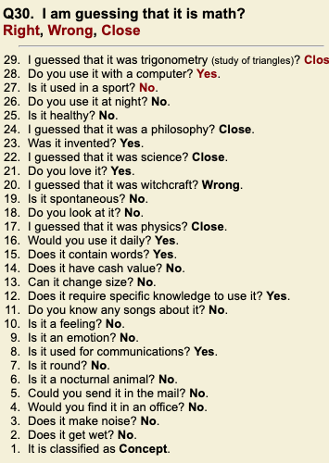
Answers for the Wandering Mind (Holiday Edition)
How can a 20-questions game get away with less?
Different answers lead to the same path (redundancy). For example, making b effectively 2 (instead of 4) results in only 2²⁰= 1,048,576 concepts. The 20-volume Oxford English Dictionary only describes 171,476 (<4⁹) words. Typically, in our every-day life we deal with about 2000-4000 concepts (<4⁶).
How can you make a 20 questions game fail?
Pick a new concept “data science”
or chose a specialized one from the dictionary!

Slide 36
Thoughts for the Wandering Mind
The computer choses a random element x of the list generated by range(0,n). What is the smallest amount of iteration/recursion steps the best ever algorithms needs to guess x?
How would the algorithm look like?

